Slide 1
Vision Transformer

Slide 2
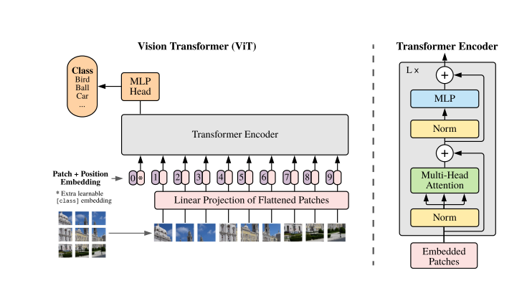
Overview
Step 3
Step 2
Step 1

Slide 3
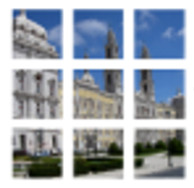

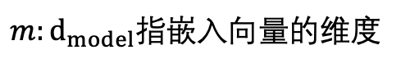

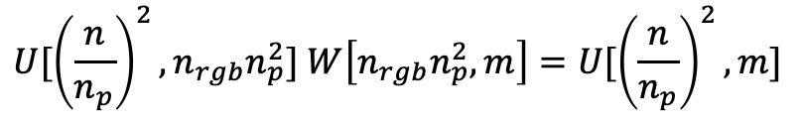


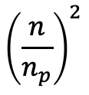
流程示意图
S1: 图像 patch 处理，线性连接层投影
将图片大小为通道为$(n ,n ,n_{rgb})$的图片进行patch分割，形成${\left(\frac{n}{n_{p}}\right)}^{2}个 \left(n_{p},n_{p},n_{rgb}\right)$大小的子图片。
将每个长度为$\left(n_{p},n_{p},n_{rgb}\right)$的子图片，进行线性拉长一维的向量$\left(n_{p}^{2}×n_{rgb},1\right)$，进行线性连接层变换成一个长度为 $m$ 的一维输入向量 $\left(m,1\right)$
0
$m:d_{model}$指嵌入向量的维度
1
嵌入向量的序列
2
0
3
1
4
$${\left(\frac{n}{n_{p}}\right)}^{2}$$
2
5
3
6
4
7
$$⋮$$
8
$${U[\left(\frac{n}{n_{p}}\right)}^{2},n_{rgb}n_{p}^{2}] W\left[n_{rgb}n_{p}^{2},m\right]={U[\left(\frac{n}{n_{p}}\right)}^{2},m]$$
$$⋮$$

Slide 4
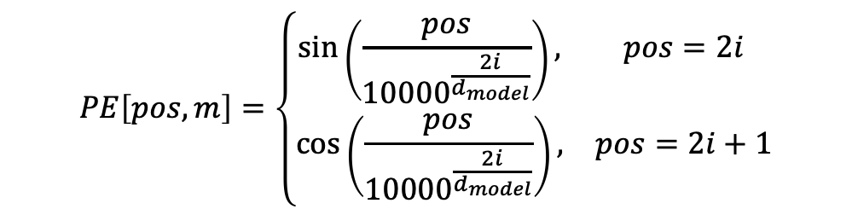
S2: Image_Info + Position-Embedding
将维度为 ${U[\left(\frac{n}{n_{p}}\right)}^{2},m]$的矩阵进行相对位置编码，位置编码参考NLP中的位置编码原则，一般选取Cos-Sin函数编码方式。
${Z_{0}\left[{\left(\frac{n}{n_{p}}\right)}^{2}+1,d_{model}\right]=contact(x_{class}[1,d_{model}];U[\left(\frac{n}{n_{p}}\right)}^{2},d_{model}$] $)+PE[:,d_{model}]$
其中$x_{class}$ 是一个含训练参数，长度为$d_{model}$的向量，位置编码信息是不含训练参数的，对于$Z_{0}\left[:, i\right]$中的每一列$i∈[0,d_{model}]$, 都需要加上与之对应的位置相关的向量。
$$PE\left[pos,m\right]=\left\{\begin{matrix}\sin\left(\frac{pos}{{10000}^{\frac{2i}{d_{model}}}}\right), & pos=2i \\ \cos\left(\frac{pos}{{10000}^{\frac{2i}{d_{model}}}}\right), & pos=2i+1\end{matrix}\right.$$
每一张图片都以大小为$Z_{0}\left[{\left(\frac{n}{n_{p}}\right)}^{2}+1,d_{model}\right]的矩阵形式$进入到Transformer架构中。

Slide 5
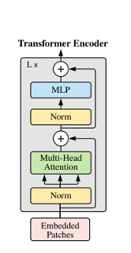


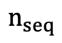

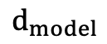
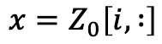

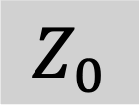
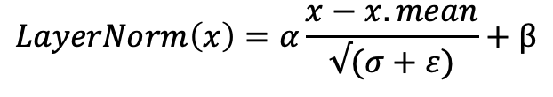

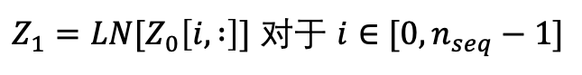


S3: Transformer 架构解析
S3.1: LayerNorm
$$d_{model}$$
$$Z_{6}$$
嵌入向量的序列
$$Z_{5}$$
$Z_{1}=LN[Z_{0}\left[i, :\right]]$ 对于 $i∈[0,n_{seq}−1]$
$$Z_{4}$$
$$Z_{0}$$
$$n_{seq}$$
$$Z_{3}$$
$$x=Z_{0}\left[i, :\right]$$
$$LayerNorm\left(x\right)=α\frac{x−x.mean}{√(σ+ε)}+β$$
$$Z_{2}$$
$$Z_{1}$$
$$Z_{0}$$

Slide 6
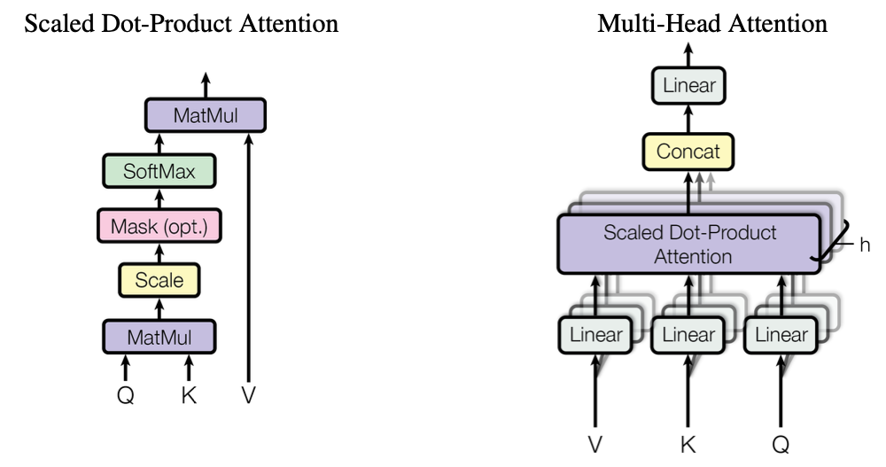
S3: Transformer 架构解析
S3.2: (Single) Multi-Head Attention (S) MHA

Slide 7












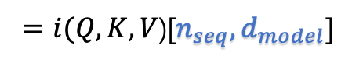




S3: Transformer 架构解析
S3.2: (Single) Multi-Head Attention (S) MHA
$$Z_{6}$$
S3.2.1: Single-Head Attention
$$Z_{5}$$
$$Q=Z_{1}W^{Q}$$
$$V=Z_{1}W^{V}$$
$$K=Z_{1}W^{K}$$
$$Z_{1}[n_{seq},d_{model}]$$
$$Z_{4}$$
$$W^{i}\left[d_{model},d_{model}\right]$$
$$Z_{3}$$
$$×$$
$=i(Q,K,V$)[$n_{seq},d_{model}$]
$$Z_{2}$$
$$Z_{0}$$
$$Z_{1}$$
$$Z_{1}$$
$$Attention(Q,K,V)=softmax\left(\frac{QK^{T}}{√d_{model}}\right)V$$
$$Z_{0}$$

Slide 8
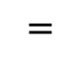





S3: Transformer 架构解析
S3.2: Multi-Head Attention MHA
$$Z_{6}$$
S3.2.1: Single-Head Attention
$$Z_{2}[n_{seq},d_{model}]$$
$$Attention(Q,K,V)=softmax\left(\frac{QK^{T}}{√d_{model}}\right)V$$
$$Z_{5}$$
$$Z_{4}$$
$$QK^{T}[n_{seq},n_{seq}]$$
$$Z_{3}$$
$$Z_{2}$$
$$Z_{0}$$
$Q$[$n_{seq},d_{model}$]
$$×$$
$$K^{T}[d_{model},n_{seq}]$$
$$Z_{1}$$
$$=$$
$$Z_{1}$$
$$Z_{0}$$
按行向量进行$softmax$操作，代表不同信息之间的关联强度。

Slide 9
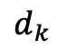
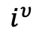
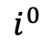

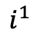
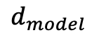
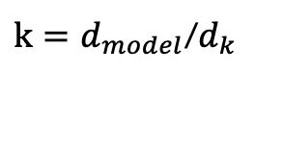
S3: Transformer 架构解析
S3.2.2: Multi-Head Attention MHA
$$Z_{6}$$
$$d_{k}$$
$$d_{model}$$
$$Z_{5}$$
$$i^{0}$$
$$i^{1}$$
$$i^{υ}$$
$$Z_{1}[n_{seq},d_{model}]$$
$k=d_{model}$/$d_{k}$
$$Z_{4}$$
$$W^{i}\left[d_{model},d_{model}\right]$$
$$Z_{3}$$
$$×$$
$=i(Q,K,V$)[$n_{seq},d_{model}$]
$$Z_{2}$$
$$Z_{1}$$
$$h_{i}[n_{seq},d_{k}]=Attention(Q^{i},K^{i},V^{i})=softmax\left(\frac{Q^{i}K^{iT}}{√d_{k}}\right)V^{i}$$
$$Z_{0}$$
多头注意力机制可并行化处理。
$$Z_{2}\left[n_{seq},d_{model}\right]=Contact\left(h_{1},h_{2},…,h_{k}\right) W^{O}[k∗d_{k},d_{model}]=MHA (Q,K,V)$$

Slide 10

S3: Transformer 架构解析
S3.2.2: MLP
$$Z_{6}$$
$$Z_{5}\left[n_{seq},d_{model}\right]=Z_{4}\left[n_{seq},d_{model}\right],W\left[d_{model},d_{MLP}\right],W[d_{MLP},d_{model}]$$
$$Z_{5}$$
$$Z_{4}$$
由两层线性连接层组成，中间层的维度为$d_{MLP}，通常选为2d_{model}$，神经元激活函数选择GELU-non linearity.
$$Z_{3}$$
S3.2.3: 残差连接(ResNet)
$$Z_{2}$$
$$Z_{0}$$
$$Z_{1}$$
$Z_{3}\left[n_{seq},d_{model}\right]=Z_{2}\left[n_{seq},d_{model}\right]$+ $Z_{0}\left[n_{seq},d_{model}\right]=f\left(x\right)+x$
$$Z_{1}$$
$$Z_{0}$$
增加模型网络的层数，缓解梯度消失或爆炸。

Slide 11




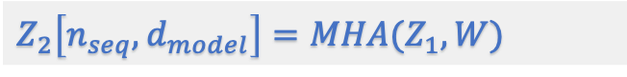


S3: Transformer 架构解析
S3.2: Multi-Head Attention MHA 一个流程内的参量变化图
$$Z_{6}$$
$Z_{6}\left[n_{seq},d_{model}\right]=$ $Z_{5}\left[n_{seq},d_{model}\right]$+ $Z_{3}\left[n_{seq},d_{model}\right]$
$$Z_{5}$$
$Z_{5}\left[n_{seq},d_{model}\right]=MLP($ $Z_{4}\left[n_{seq},d_{model}\right],W\left[d_{model},d_{hidden}\right],W\left[d_{hidden},d_{model}\right])$
$$Z_{4}$$
$Z_{4}\left[n_{seq},d_{model}\right]=LN($ $Z_{3}\left[n_{seq},d_{model}\right])$
$$Z_{3}$$
$Z_{3}\left[n_{seq},d_{model}\right]=Z_{2}\left[n_{seq},d_{model}\right]$+ $Z_{0}\left[n_{seq},d_{model}\right]$
$$Z_{2}$$
$$Z_{2}\left[n_{seq},d_{model}\right]=MHA(Z_{1},W)$$
$$Z_{1}$$
$Z_{1}\left[n_{seq},d_{model}\right]=LN($ $Z_{0}\left[n_{seq},d_{model}\right])$按照行向量进行归一化
$$Z_{0}$$
$$注：只要涉及到线性层，MHA里的除外，其余自动加上bias.$$

Slide 12
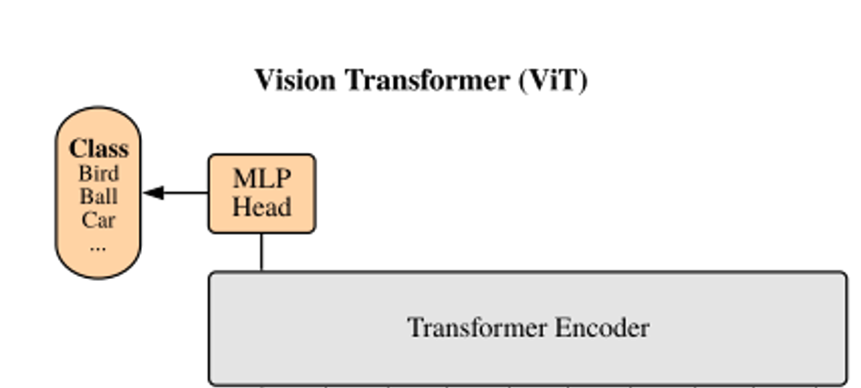

S3: Transformer 架构解析
S3.2.2: 分类
这样重复L层Transformer后的输出矩阵为：
$$Y=Z_{6}\left[n_{seq}=0,d_{model}\right]$$
选择将输出的*head连接一个分类的全连接层后，使用softmax函数分类，可以得出交叉熵并且采取反向传播更换参数梯度。

Slide 13
Other variant
选择将输出的*head连接一个分类的全连接层后，使用softmax函数分类，可以得出交叉熵并且采取反向传播更换参数梯度。

Slide 14
Quantum Vision Transformer
parametrized quantum circuit for matrix-vector multiplication

Slide 15



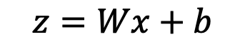

本质：如何处理含可训练权重参数的矩阵与向量乘法？
$$x$$
$$W$$
0
$$z$$
1
2
0
$$z=Wx+b$$
3
1
4
2
5
3
$$z=σ(z)$$
6
4
7
$$⋮$$
8
$$⋮$$

Slide 16
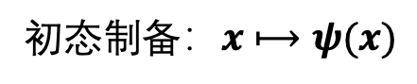
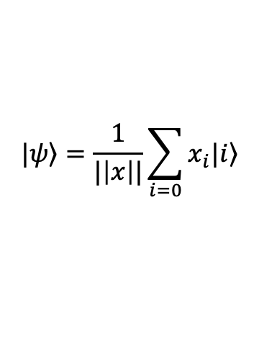

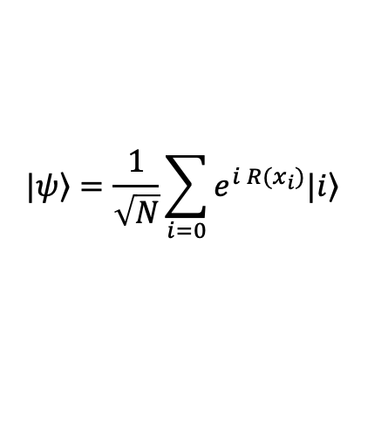
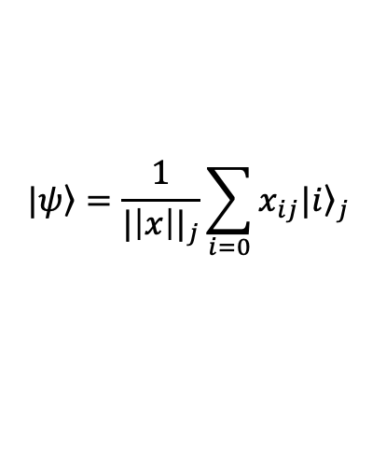
数据编码：如何将经典数据编码量子态？
经典数据$编码到量子态：x=(x_{0},x_{1},x_{2}…,x_{d})∈ℝ$
初态$制备：x⟼ψ(x)$
角度编码
$$|\left.ψ\right\rangle =\frac{1}{\sqrt{N}}\sum_{i=0}{e^{{i R(x}_{i})}|\left.i\right\rangle }$$
量子线路制备简单，需要$ο\left(N\right)的空间表示N个数据点。$
振幅编码
$$|\left.ψ\right\rangle =\frac{1}{|\left|x\right||}\sum_{i=0}{x_{i}|\left.i\right\rangle }$$
高效，在$ο\left(\log{N}\right)的空间表示N个数据点；$需要复杂线路制备量子态。
位编码
使用量子比特的基态表示二进制数据，如$|\left.101\right\rangle 表示\left(101\right)。$
混合编码
结合以上方法的特征，保证编码效率和编码特征的平衡。
$$|\left.ψ\right\rangle =\frac{1}{{|\left|x\right||}_{j}}\sum_{i=0}{x_{ij}|{\left.i\right\rangle }_{j}}$$
﻿Quantum convolutional neural network for classical data classification, Tak Hur et al., Quantum Machine Intelligence(2022) 4:3.

Slide 17
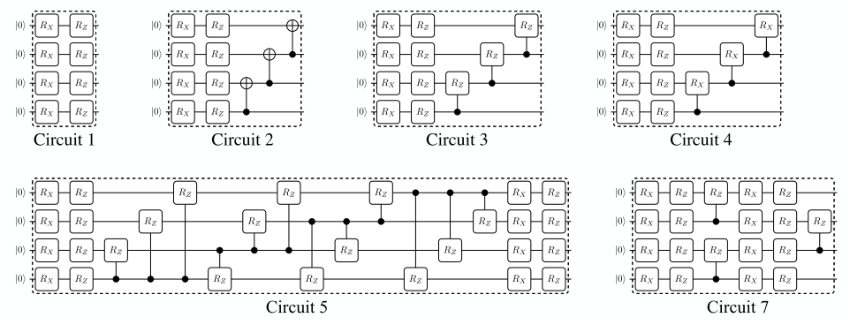
方案一：含参数酉矩阵的纠缠线路
$$如何构建W?$$
$R_{y}\left(θ\right)=e^{−iσ_{y}θ/2}$= $\left(\begin{matrix}cos\left(θ/2\right) & −sin\left(θ/2\right) \\ sin\left(θ/2\right) & cos\left(θ/2\right)\end{matrix}\right),$ $R_{x}\left(θ\right)=e^{−iσ_{x}θ/2}$= $\left(\begin{matrix}cos\left(θ/2\right) & −sin\left(θ/2\right) \\ −sin\left(θ/2\right) & cos\left(θ/2\right)\end{matrix}\right)$

Slide 18
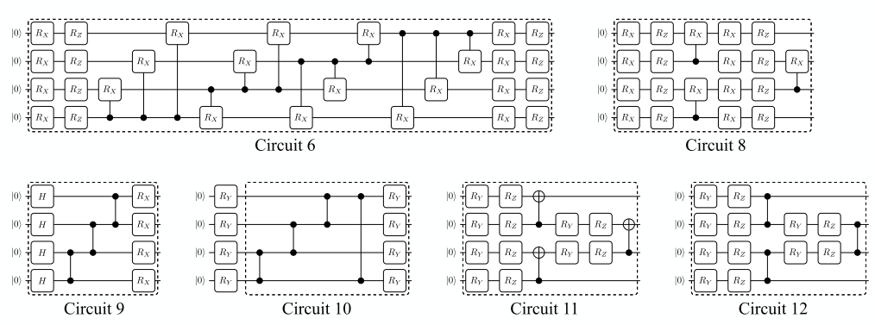
方案一：含参数酉矩阵的纠缠线路

Slide 19
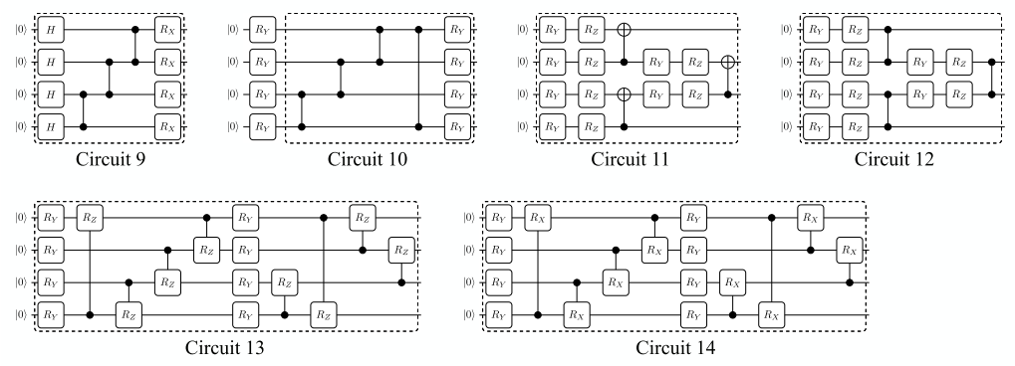
方案一：含参数酉矩阵的纠缠线路

Slide 20
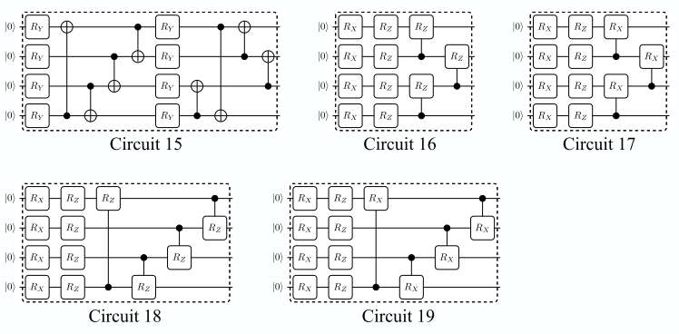
方案一：含参数酉矩阵的纠缠线路
﻿Circuit-block construction for data classification: 13-15 and 18-19。

Slide 21
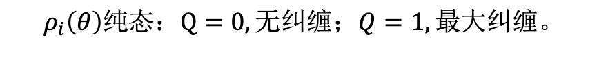
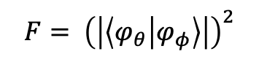
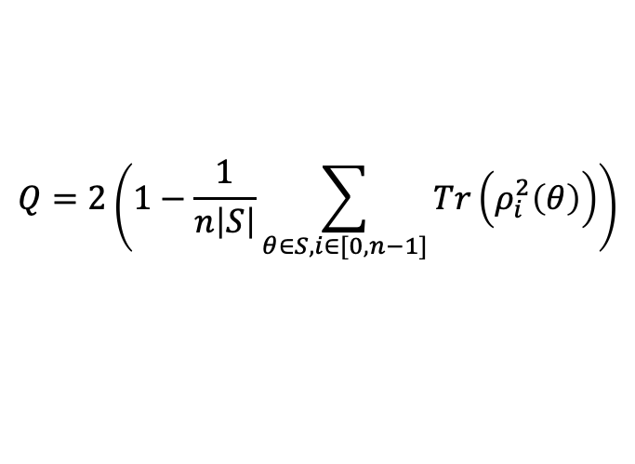

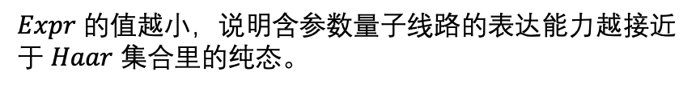
含参数量子线路：如何评估？
Expressibility （表达力）
定义为一个量子线路生成纯态的能力，用在参数随机采样空间产生的量子态的密度矩阵与在Haar酉矩阵集合中随机采样的纯态的密度矩阵的空间距离来衡量；
﻿$F= {\left(\left|\left\langle φ_{θ} | φ_{φ}\right\rangle \right|\right)}^{2}$
﻿$Expr = D_{KL}\left( {\hat{P}}_{PQC}\left(F; θ\right)||P_{Haar}\left(F\right)\right)$
$Expr$ 的值越小，说明含参数量子线路的表达能力越接近于 $Haar$ 集合里的纯态。
Entanglement （纠缠度）
$$Meyer−Wallach measure$$
$$Q=2\left(1−\frac{1}{n\left|S\right|}\sum_{θ∈S,i∈[0,n−1]}{Tr\left(ρ_{i}^{2}\left(θ\right)\right)}\right)$$
$ρ_{i}\left(θ\right)\text{表示}在参数\left(θ\right)下，\text{对系统中的其他所有量子比特进行部分迹操作后得到的第}\text{i}\text{个量子比特的约化密度矩阵}$。
$$ρ_{i}\left(θ\right)纯态：Q=0,无纠缠；Q=1, 最大纠缠。$$

Slide 22
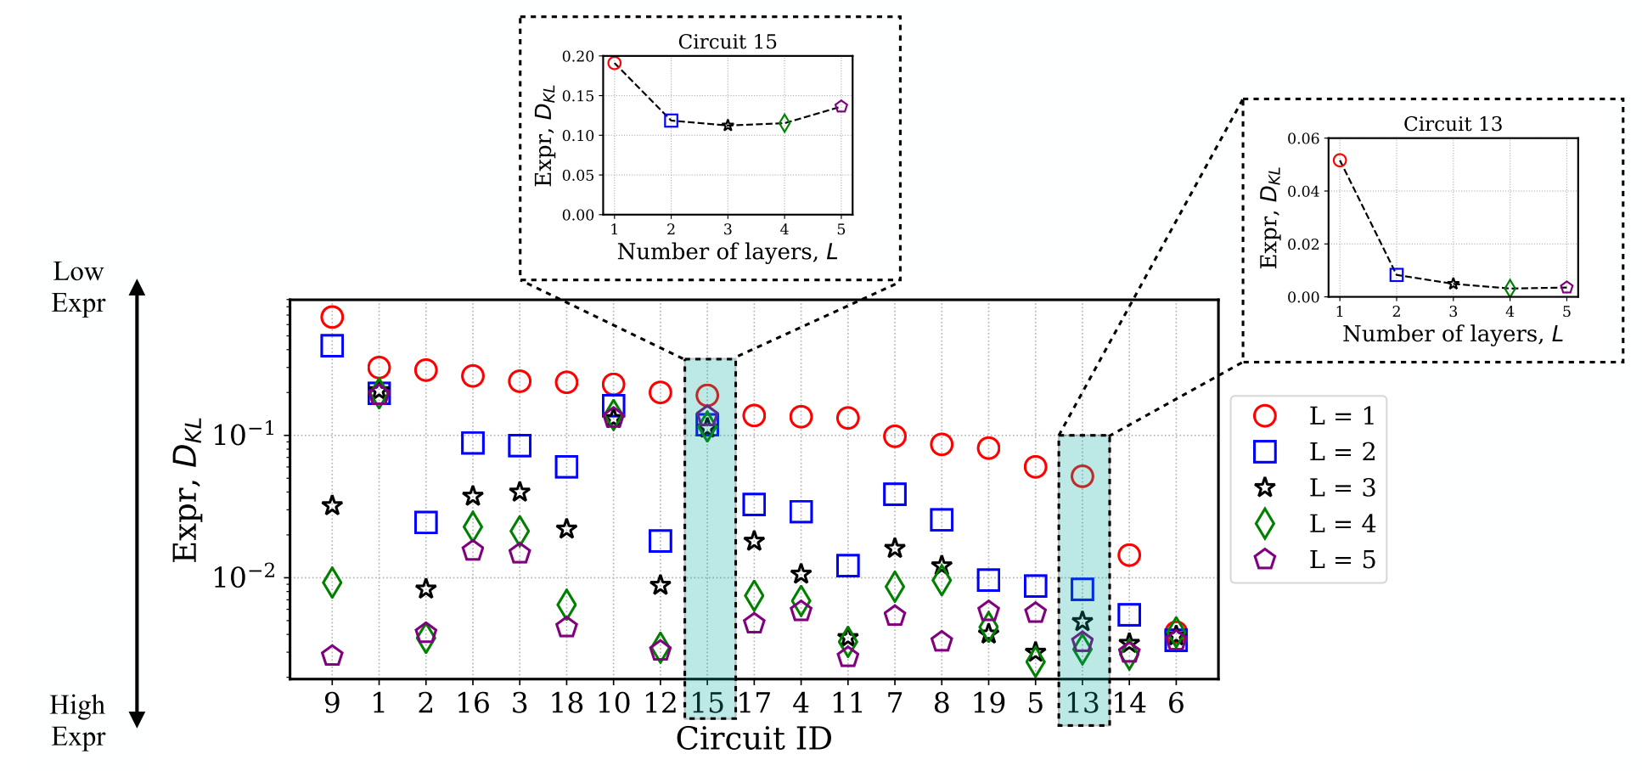
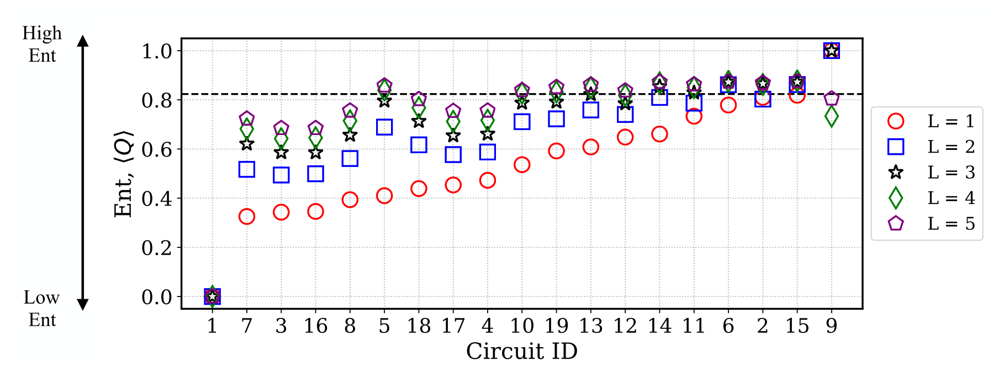
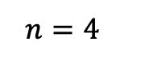
Expressibility&Entanglement
﻿$n=4$
不同构型的量子电路的表达性与
层数之间的关系；
不同构型的量子电路的纠缠性与
层数之间的关系；
要把这方面的实现代码补齐！
输入：一个含参数的量子线路；
输出就是上图所示的两张图。

Slide 23
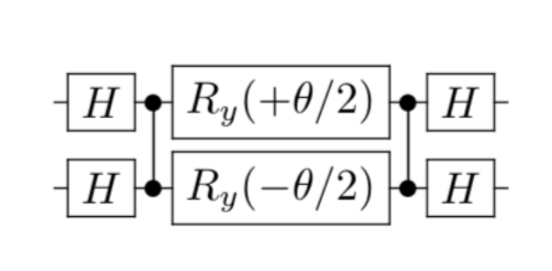

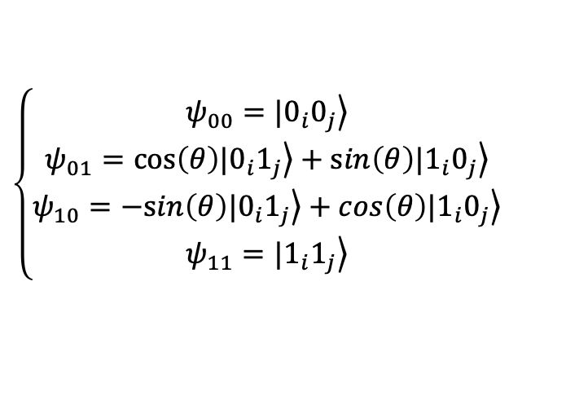
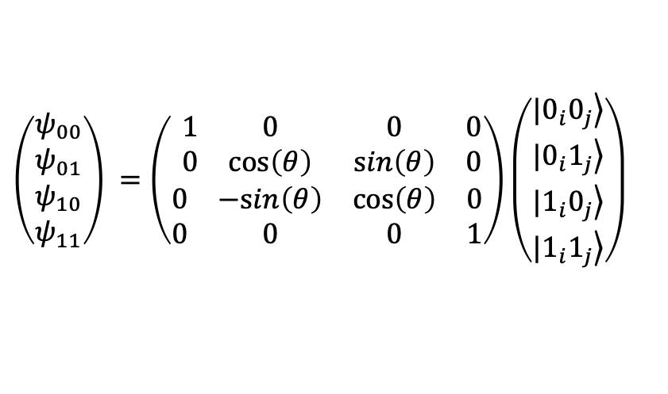
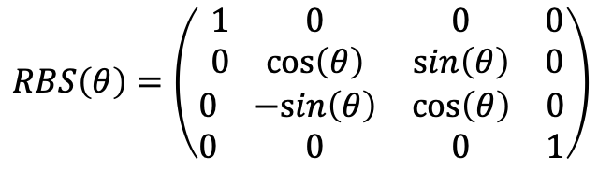
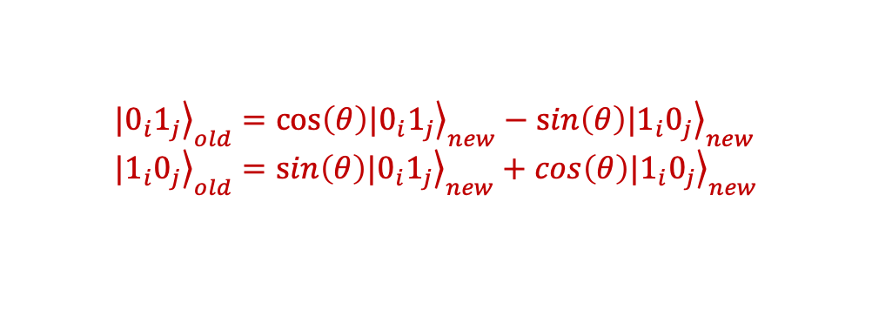
方案二：含参数正交酉矩阵的纠缠线路
fSIM Gate (﻿Reconfigurable Beam Splitter gate (RBS))
$$RBS\left(θ\right)=\left(\begin{matrix}\begin{matrix}1 & 0 \\ 0 & cos\left(θ\right)\end{matrix} & \begin{matrix}0 & 0 \\ sin\left(θ\right) & 0\end{matrix} \\ \begin{matrix}0 & −sin\left(θ\right) \\ 0 & 0\end{matrix} & \begin{matrix}cos\left(θ\right) & 0 \\ 0 & 1\end{matrix}\end{matrix}\right)$$
线路可能的一种拆解方法
矩阵表达
操作效果
$$\left(\begin{matrix}\begin{matrix}ψ_{00} \\ ψ_{01}\end{matrix} \\ \begin{matrix}ψ_{10} \\ ψ_{11}\end{matrix}\end{matrix}\right) =\left(\begin{matrix}\begin{matrix}1 & 0 \\ 0 & cos\left(θ\right)\end{matrix} & \begin{matrix}0 & 0 \\ sin\left(θ\right) & 0\end{matrix} \\ \begin{matrix}0 & −sin\left(θ\right) \\ 0 & 0\end{matrix} & \begin{matrix}cos\left(θ\right) & 0 \\ 0 & 1\end{matrix}\end{matrix}\right)\left(\begin{matrix}\begin{matrix}\left.|0_{i}0_{j}\right\rangle \\ \left.{|0}_{i}1_{j}\right\rangle \end{matrix} \\ \begin{matrix}\left.{|1}_{i}0_{j}\right\rangle \\ \left.{|1}_{i}1_{j}\right\rangle \end{matrix}\end{matrix}\right)$$
$$\left\{\begin{matrix}\begin{matrix}ψ_{00}=\left.|0_{i}0_{j}\right\rangle \\ ψ_{01}=cos\left(θ\right)\left.|0_{i}1_{j}\right\rangle +sin\left(θ\right)\left.{|1}_{i}0_{j}\right\rangle \end{matrix} \\ \begin{matrix}ψ_{10}=−sin\left(θ\right)\left.|0_{i}1_{j}\right\rangle +cos\left(θ\right)\left.{|1}_{i}0_{j}\right\rangle \\ ψ_{11}=\left.|1_{i}1_{j}\right\rangle \end{matrix}\end{matrix}\right.$$
$${\left.|0_{i}1_{j}\right\rangle }_{old}=cos\left(θ\right){\left.|0_{i}1_{j}\right\rangle }_{new}−sin\left(θ\right){\left.{|1}_{i}0_{j}\right\rangle }_{new} \\ {\left.|1_{i}0_{j}\right\rangle }_{old}=sin\left(θ\right){\left.|0_{i}1_{j}\right\rangle }_{new}+cos\left(θ\right){\left.{|1}_{i}0_{j}\right\rangle }_{new}$$
约定：$\left(\begin{matrix}cos\left(θ/2\right) & −sin\left(θ/2\right) \\ sin\left(θ/2\right) & cos\left(θ/2\right)\end{matrix}\right)=R_{y}\left(θ\right)=e^{−iσ_{y}θ/2}$
Quantum Methods for Neural Networks and Application to Medical Image Classification, Jonas Landman, et al., Quantum 6, 881 (2022).

Slide 24
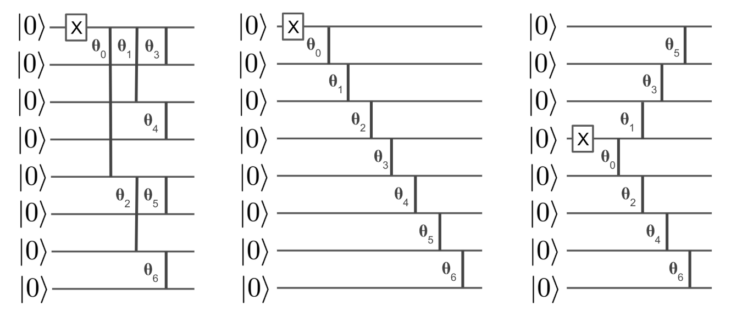
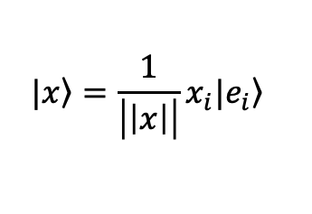
方案二：含参数正交酉矩阵的纠缠线路
经典数据编码：unary encoding
a
b
c
$$|\left.x\right\rangle =\frac{1}{\left|\left|x\right|\right|}x_{i}|\left.e_{i}\right\rangle$$
Quantum Methods for Neural Networks and Application to Medical Image Classification, Jonas Landman, et al., Quantum 6, 881 (2022).

Slide 25
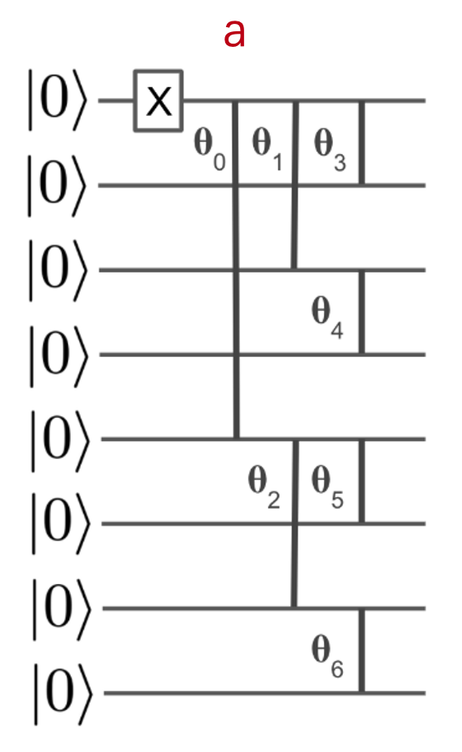
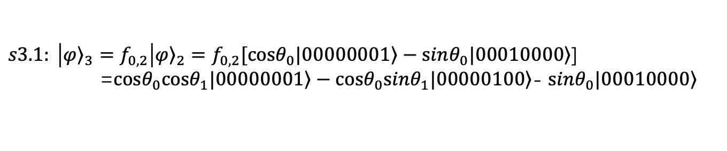
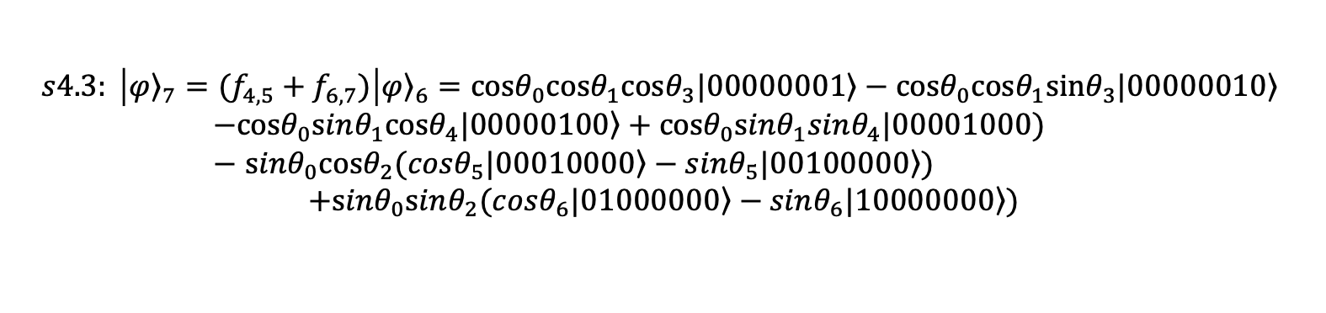







一维数据的fSIM编码方式：
$${\left.|0_{i}1_{j}\right\rangle }_{old}=cos\left(θ\right){\left.|0_{i}1_{j}\right\rangle }_{new}−sin\left(θ\right){\left.{|1}_{i}0_{j}\right\rangle }_{new} \\ {\left.|1_{i}0_{j}\right\rangle }_{old}=sin\left(θ\right){\left.|0_{i}1_{j}\right\rangle }_{new}+cos\left(θ\right){\left.{|1}_{i}0_{j}\right\rangle }_{new}$$
$$s0: |{\left.φ\right\rangle }_{0}=|\left.00000000\right\rangle$$
$$s1: \left|{\left.φ\right\rangle }_{1}=X_{0}\right|{\left.φ\right\rangle }_{0}=|\left.00000001\right\rangle$$
$$s2: \left|{\left.φ\right\rangle }_{2}=f_{0,4}\right|{\left.φ\right\rangle }_{1}=f_{0,4}|\left.00000001\right\rangle =cosθ_{0}\left.|{0000}_{4}0001_{0}\right\rangle −sinθ_{0}\left.|{0001}_{4}0000_{0}\right\rangle$$
$s3.1: \left|{\left.φ\right\rangle }_{3}=f_{0,2}\right|{\left.φ\right\rangle }_{2}=f_{0,2}[cosθ_{0}\left.|00000001\right\rangle −sinθ_{0}\left.|00010000\right\rangle$] =$cosθ_{0}\left.cosθ_{1}|00000001\right\rangle −cosθ_{0}\left.sinθ_{1}|00000100\right\rangle$- $sinθ_{0}\left.|00010000\right\rangle$
$$s3.2: \left|{\left.φ\right\rangle }_{4}=f_{4,6}\right|{\left.φ\right\rangle }_{3}=cosθ_{0}\left.cosθ_{1}|00000001\right\rangle −cosθ_{0}\left.sinθ_{1}|00000100\right\rangle$$ $−$ $sinθ_{0}cosθ_{2}\left.|00010000\right\rangle +sinθ_{0}sinθ_{2}\left.|01000000\right\rangle$
$$s4.1: \left|{\left.φ\right\rangle }_{5}=f_{0,1}\right|{\left.φ\right\rangle }_{4}=cosθ_{0}\left.cosθ_{1}(cosθ_{3}|00000001\right\rangle −sinθ_{3}\left.|00000010\right\rangle ⁡)$$ $−cosθ_{0}\left.sinθ_{1}|00000100\right\rangle −$ $sinθ_{0}cosθ_{2}\left.|00010000\right\rangle +sinθ_{0}sinθ_{2}\left.|01000000\right\rangle$
$$s4.2: \left|{\left.φ\right\rangle }_{6}=f_{2,3}\right|{\left.φ\right\rangle }_{5}=cosθ_{0}\left.cosθ_{1}cosθ_{3}|00000001\right\rangle −cosθ_{0}cosθ_{1}sinθ_{3}\left.|00000010\right\rangle ⁡$$ $−cosθ_{0}\left.sinθ_{1}cosθ_{4}|00000100\right\rangle +cosθ_{0}sinθ_{1}sinθ_{4}|00001000)$ $−$ $sinθ_{0}cosθ_{2}\left.|00010000\right\rangle +sinθ_{0}sinθ_{2}\left.|01000000\right\rangle$
$$s4.3: \left|{\left.φ\right\rangle }_{7}=(f_{4,5}+f_{6,7})\right|{\left.φ\right\rangle }_{6}=cosθ_{0}\left.cosθ_{1}cosθ_{3}|00000001\right\rangle −cosθ_{0}cosθ_{1}sinθ_{3}\left.|00000010\right\rangle ⁡$$ $−cosθ_{0}\left.sinθ_{1}cosθ_{4}|00000100\right\rangle +cosθ_{0}sinθ_{1}sinθ_{4}|00001000)$ $−$ $sinθ_{0}cosθ_{2}\left.(cosθ_{5}|00010000\right\rangle −sinθ_{5}\left.|00100000\right\rangle )$ $$+sinθ_{0}sinθ_{2}\left.(cosθ_{6}|01000000\right\rangle −sinθ_{6}\left.|10000000\right\rangle )$$
Quantum Methods for Neural Networks and Application to Medical Image Classification, Jonas Landman, et al., Quantum 6, 881 (2022).

Slide 26









$$|\left.x\right\rangle =\frac{1}{\left|\left|x\right|\right|}x_{i}|\left.e_{i}\right\rangle =cosθ_{0}cosθ_{1}cosθ_{3}\left.|00000001\right\rangle −cosθ_{0}cosθ_{1}sinθ_{3}\left.|00000010\right\rangle ⁡$$ $−cosθ_{0}sinθ_{1}cosθ_{4}\left.|00000100\right\rangle$
$$+cosθ_{0}sinθ_{1}sinθ_{4}\left.|00001000\right\rangle ⁡$$ $−$ $sinθ_{0}cosθ_{2}\left.cosθ_{5}|00010000\right\rangle$
$$+sinθ_{0}cosθ_{2}sinθ_{5}\left.|00100000\right\rangle \\ +sinθ_{0}sinθ_{2}\left.cosθ_{6}|01000000\right\rangle −sinθ_{0}sinθ_{2}sinθ_{6}\left.|10000000\right\rangle$$
$$x_{0}=cosθ_{0}cosθ_{1}cosθ_{3} \\ x_{1}=−cosθ_{0}cosθ_{1}sinθ_{3}$$
$$x_{2}=−cosθ_{0}sinθ_{1}cosθ_{4}$$
$$x_{3}=cosθ_{0}sinθ_{1}sinθ_{4}$$
$$x_{4}=−sinθ_{0}cosθ_{2}cosθ_{5}$$
$$x_{5}=sinθ_{0}cosθ_{2}sinθ_{5}$$
$$x_{6}=sinθ_{0}sinθ_{2}cosθ_{6} \\ x_{7}=sinθ_{0}sinθ_{2}sinθ_{6}$$
$$x=(x_{0},x_{1},x_{2}…,x_{7})∈ℝ^{d}$$
$$θ=\left(θ_{0},θ_{1},θ_{2}…,θ_{6}\right)∈ℝ^{d−1}$$
$$r=\left(r_{0},r_{1},r_{2}…,r_{6}\right)∈ℝ^{d−1}$$
$$θ_{r}=\left(θ_{3},θ_{4},θ_{5},θ_{6}\right)$$
$$θ_{\frac{d−2}{2}+j}=\arccos\left(\frac{x_{2j}}{\sqrt{x_{2j+1}^{2}+x_{2j}^{2}}}\right)=\arccos\left(\frac{x_{2j}}{r_{\frac{d−2}{2}+j}}\right) ,x_{2j}>0;j∈\left[0,\frac{d−2}{2}\right]$$
$${cosθ}_{3}=x_{0}/\sqrt{x_{1}^{2}+x_{0}^{2}},j=0$$
$${cosθ}_{4}=x_{2}/\sqrt{x_{3}^{2}+x_{2}^{2}},j=1$$
$${cosθ}_{5}=x_{4}/\sqrt{x_{5}^{2}+x_{4}^{2}},j=2$$
$${cosθ}_{6}=x_{6}/\sqrt{x_{7}^{2}+x_{6}^{2}},j=3$$
$$r_{r}=\left(r_{3},r_{4},r_{5},r_{6}\right)$$
$$r_{\frac{d−2}{2}+j}=\sqrt{x_{2j+1}^{2}+x_{2j}^{2}},j∈\left[0,\frac{d−2}{2}\right]$$
$$r_{3}=\sqrt{x_{1}^{2}+x_{0}^{2}},j=0$$
$$r_{4}=\sqrt{x_{3}^{2}+x_{2}^{2}},j=1$$
$$r_{5}=\sqrt{x_{5}^{2}+x_{4}^{2}},j=2$$
$$r_{6}=\sqrt{x_{7}^{2}+x_{6}^{2}},j=3$$

Slide 27




$$|\left.x\right\rangle =\frac{1}{\left|\left|x\right|\right|}x_{i}|\left.e_{i}\right\rangle =cosθ_{0}cosθ_{1}cosθ_{3}\left.|00000001\right\rangle −cosθ_{0}cosθ_{1}sinθ_{3}\left.|00000010\right\rangle ⁡$$ $−cosθ_{0}sinθ_{1}cosθ_{4}\left.|00000100\right\rangle$
$$+cosθ_{0}sinθ_{1}sinθ_{4}\left.|00001000\right\rangle ⁡$$ $−$ $sinθ_{0}cosθ_{2}\left.cosθ_{5}|00010000\right\rangle$
$$+sinθ_{0}cosθ_{2}sinθ_{5}\left.|00100000\right\rangle \\ +sinθ_{0}sinθ_{2}\left.cosθ_{6}|01000000\right\rangle −sinθ_{0}sinθ_{2}sinθ_{6}\left.|10000000\right\rangle$$
$$x_{0}=cosθ_{0}cosθ_{1}cosθ_{3} \\ x_{1}=−cosθ_{0}cosθ_{1}sinθ_{3}$$
$$x_{2}=−cosθ_{0}sinθ_{1}cosθ_{4}$$
$$x_{3}=cosθ_{0}sinθ_{1}sinθ_{4}$$
$$x_{4}=−sinθ_{0}cosθ_{2}cosθ_{5}$$
$$x_{5}=sinθ_{0}cosθ_{2}sinθ_{5}$$
$$x_{6}=sinθ_{0}sinθ_{2}cosθ_{6} \\ x_{7}=sinθ_{0}sinθ_{2}sinθ_{6}$$
$$x=(x_{0},x_{1},x_{2}…,x_{7})∈ℝ^{d}$$
$$θ=\left(θ_{0},θ_{1},θ_{2}…,θ_{6}\right)∈ℝ^{d−1}$$
$$r=\left(r_{0},r_{1},r_{2}…,r_{6}\right)∈ℝ^{d−1}$$
$$θ_{l}=\left(θ_{0},θ_{1},θ_{2} \right)$$
$r_{1}=$ $\sqrt{r_{3}^{2}+r_{4}^{2}}=\left|cosθ_{0}\right|;$ $r_{3}=\sqrt{x_{1}^{2}+x_{0}^{2}}=$ $\sqrt{{(cosθ_{0}cosθ_{1})}^{2}},r_{4}=\sqrt{x_{3}^{2}+x_{2}^{2}}= \sqrt{{(cosθ_{0}sinθ_{1})}^{2}};$ $r_{0}=\sqrt{r_{1}^{2}+r_{2}^{2}}=$ $\sin^{2}{θ_{0}}$+ $\cos^{2}{θ_{0}=1}$ $r_{2}^{2}=$ $\sqrt{r_{5}^{2}+r_{6}^{2}}=\sin^{2}{θ_{0}},r_{5}$= $\sqrt{{(sinθ_{0}cosθ_{2})}^{2}},$ $r_{6}$= $\sqrt{{(sinθ_{0}sinθ_{2})}^{2}};$
$$θ_{0}=\arccos\left(\frac{r_{1}}{r_{0}}\right);$$
$$θ_{1}=\arccos\left(\frac{r_{3}}{r_{1}}\right);$$
$$θ_{2}=\arccos\left(\frac{r_{5}}{r_{2}}\right);$$
$$r_{l}=\left(r_{0},r_{1},r_{2} \right)$$
$$r_{j}=\sqrt{r_{2j+1}^{2}+r_{2j+2}^{2}},j∈\left[0,\frac{d−2}{2}−1\right]$$
$$r_{0}=\sqrt{r_{1}^{2}+r_{2}^{2}},j=0$$
$$r_{1}=\sqrt{r_{3}^{2}+r_{4}^{2}},j=1$$
$$r_{2}=\sqrt{r_{5}^{2}+r_{6}^{2}},j=2$$
$$θ_{j}=arccos⁡(\frac{r_{2j+1}}{r_{j}})$$

Slide 28









$$s0: |{\left.φ\right\rangle }_{0}=|\left.00000000\right\rangle$$
$$s1: \left|{\left.φ\right\rangle }_{1}=X_{0}\right|{\left.φ\right\rangle }_{0}=|\left.00000001\right\rangle$$
$$s2: \left|{\left.φ\right\rangle }_{2}=f_{0,1}\right|{\left.φ\right\rangle }_{1}=f_{0,1}|\left.00000001\right\rangle =cosθ_{0}\left.|00000001\right\rangle −sinθ_{0}\left.|00000010\right\rangle$$
$s3: \left|{\left.φ\right\rangle }_{3}=f_{1,2}\right|{\left.φ\right\rangle }_{2}=cosθ_{0}\left.|00000001\right\rangle −cosθ_{1}sinθ_{0}\left.|00000010\right\rangle +$ $sinθ_{1}sinθ_{0}\left.|00000100\right\rangle$
$$s4: \left|{\left.φ\right\rangle }_{4}=f_{2,3}\right|{\left.φ\right\rangle }_{3}=cosθ_{0}\left.|00000001\right\rangle −cosθ_{1}sinθ_{0}\left.|00000010\right\rangle$$ $+$ $cosθ_{2}$ $sinθ_{1}sinθ_{0}\left.|00000100\right\rangle −sinθ_{2}sinθ_{1}sinθ_{0}\left.|00001000\right\rangle$
$$s5: \left|{\left.φ\right\rangle }_{5}=f_{3,4}\right|{\left.φ\right\rangle }_{4}=cosθ_{0}\left.|00000001\right\rangle −cosθ_{1}sinθ_{0}\left.|00000010\right\rangle$$ $+$ $cosθ_{2}$ $sinθ_{1}sinθ_{0}\left.|00000100\right\rangle −cosθ_{3}sinθ_{2}sinθ_{1}sinθ_{0}\left.|00001000\right\rangle$ $+$ $sinθ_{3}sinθ_{2}sinθ_{1}sinθ_{0}\left.|00010000\right\rangle$
$$s6: \left|{\left.φ\right\rangle }_{6}=f_{4,5}\right|{\left.φ\right\rangle }_{5}=cosθ_{0}\left.|00000001\right\rangle −cosθ_{1}sinθ_{0}\left.|00000010\right\rangle$$ $+$ $cosθ_{2}$ $sinθ_{1}sinθ_{0}\left.|00000100\right\rangle −cosθ_{3}sinθ_{2}sinθ_{1}sinθ_{0}\left.|00001000\right\rangle$ $+$ $cosθ_{4}$ $sinθ_{3}sinθ_{2}sinθ_{1}sinθ_{0}\left.|00010000\right\rangle$
$−sinθ_{4}$ $sinθ_{3}sinθ_{2}sinθ_{1}sinθ_{0}\left.|00100000\right\rangle$
$$s7: \left|{\left.φ\right\rangle }_{7}=f_{5,6}\right|{\left.φ\right\rangle }_{6}=cosθ_{0}\left.|00000001\right\rangle −cosθ_{1}sinθ_{0}\left.|00000010\right\rangle$$ $+$ $cosθ_{2}$ $sinθ_{1}sinθ_{0}\left.|00000100\right\rangle −cosθ_{3}sinθ_{2}sinθ_{1}sinθ_{0}\left.|00001000\right\rangle$ $+$ $cosθ_{4}$ $sinθ_{3}sinθ_{2}sinθ_{1}sinθ_{0}\left.|00010000\right\rangle$
$−cosθ_{5}sinθ_{4}$ $sinθ_{3}sinθ_{2}sinθ_{1}sinθ_{0}\left.|00100000\right\rangle$ $+$ $sinθ_{5}sinθ_{4}$ $sinθ_{3}sinθ_{2}sinθ_{1}sinθ_{0}\left.|01000000\right\rangle$

Slide 29



$$|\left.x\right\rangle =\frac{1}{\left|\left|x\right|\right|}x_{i}|\left.e_{i}\right\rangle$$ =$cosθ_{0}\left.|00000001\right\rangle$
$$−cosθ_{1}sinθ_{0}\left.|00000010\right\rangle$$ $+$ $cosθ_{2}$ $sinθ_{1}sinθ_{0}\left.|00000100\right\rangle$
$$−cosθ_{3}sinθ_{2}sinθ_{1}sinθ_{0}\left.|00001000\right\rangle$$ $+$ $cosθ_{4}$ $sinθ_{3}sinθ_{2}sinθ_{1}sinθ_{0}\left.|00010000\right\rangle$
$−cosθ_{5}sinθ_{4}$ $sinθ_{3}sinθ_{2}sinθ_{1}sinθ_{0}\left.|00100000\right\rangle$ $+$ $cosθ_{6} sinθ_{5}sinθ_{4}sinθ_{3}sinθ_{2}sinθ_{1}sinθ_{0}\left.|01000000\right\rangle$ $−$ $sinθ_{6} sinθ_{5}sinθ_{4}$ $sinθ_{3}sinθ_{2}sinθ_{1}sinθ_{0}\left.|10000000\right\rangle$
$$x_{0}=cosθ_{0} \\ x_{1}=−cosθ_{1}sinθ_{0}$$
$$x_{2}=+ cosθ_{2} sinθ_{1}sinθ_{0}$$
$$x_{3}=−cosθ_{3}sinθ_{2}sinθ_{1}sinθ_{0}$$
$$x_{4}=+ cosθ_{4} sinθ_{3}sinθ_{2}sinθ_{1}sinθ_{0}$$
$$x_{5}=−cosθ_{5}sinθ_{4} sinθ_{3}sinθ_{2}sinθ_{1}sinθ_{0}$$
$$x_{6}=+ cosθ_{6} sinθ_{5}sinθ_{4}sinθ_{3}sinθ_{2}sinθ_{1}sinθ_{0} \\ x_{7}=− sinθ_{6} sinθ_{5}sinθ_{4} sinθ_{3}sinθ_{2}sinθ_{1}sinθ_{0}$$
${θ_{0}=arccos⁡(x}_{0}),sin$ $θ_{0}=\sqrt{1−x_{0}^{2}}$ $θ_{1}=\arccos\left(−\frac{x_{1}}{sin θ_{0}}\right)=\arccos\left(−\frac{x_{1}}{\sqrt{1−x_{0}^{2}}}\right),$ $sin$ $θ_{1}=\sqrt{1−\frac{x_{1}^{2}}{1−x_{0}^{2}}}$
$$θ_{2}=\arccos\left(\frac{x_{2}}{sinθ_{1}sinθ_{0}}\right)=\arccos\left(\frac{x_{2}}{\sqrt{1−\frac{x_{1}^{2}}{1−x_{0}^{2}}}\sqrt{1−x_{0}^{2}}}\right)=\arccos\left(\frac{x_{2}}{\sqrt{1−x_{1}^{2}−x_{0}^{2}}}\right),sin θ_{2}=\sqrt{1−\frac{x_{2}^{2}}{1−x_{1}^{2}−x_{0}^{2}}}$$
$$θ_{j}=\arccos\left({\left(−1\right)}^{i}\frac{x_{i}}{Π_{j=0}^{i−1}sinθ_{j}}\right)=\arccos\left({\left(−1\right)}^{i}\frac{x_{i}}{\sqrt{1−Σ_{j=0}^{i−1}x_{j}^{2}}}\right) for i≤6$$
对于最后一个角度，需要检查sin（ $θ_{j}$）的符号，确定$θ_{j}$的最终取值。
$sin$ $θ_{j}>0, θ_{j}=arccos$ $\left({\left(−1\right)}^{i}\frac{x_{i}}{Π_{j=0}^{i−1}sinθ_{j}}\right);sin θ_{j}<0, θ_{j}\text{=}\text{2}π−arccos \left({\left(−1\right)}^{i}\frac{x_{i}}{Π_{j=0}^{i−1}sinθ_{j}}\right)$

Slide 30

步骤同 a 和 b，读者可自行进行归纳推导，也可自行设计含fSIM门的量子线路设计。

Slide 31






高维数据的fSIM编码方式：
$|\left.x\right\rangle =\frac{1}{\left|\left|x\right|\right|}x_{ij}|\left.e_{i}\right\rangle$ $|\left.e_{j}\right\rangle ,|\left.e_{i}\right\rangle$代表行$,|\left.e_{j}\right\rangle 代表列$
$那么可以用两个向量去表示$二维矩阵：
$$a_{i}=\left(x_{i,0},x_{i,1},x_{i,2}…,x_{i,m}\right)∈ℝ,b=(\left|a_{0}\right|,\left|a_{1}\right|,\left|a_{2}\right|,…,\left|a_{n}\right|)$$
分别归一化处理向量$a_{i}$和$b$
$$a_{0}=\left(x_{00},x_{01}\right) \\ a_{1}=\left(x_{10},x_{11}\right)$$
$$a_{2}=\left(x_{20},x_{21}\right)$$
$$b=(\left|a_{0}\right|,\left|a_{1}\right|,\left|a_{2}\right|)$$
$$X=\left[\begin{matrix}\begin{aligned}x_{00} \\ x_{10}\end{aligned} & \begin{aligned}x_{01} \\ x_{11}\end{aligned} \\ x_{20} & x_{21}\end{matrix}\right]$$
分别 Load向量$b$和$a_{i}$

Slide 32





















1
2
3
4
$$|\left.0\right\rangle$$
$$X$$
$$a_{0}=\left(x_{00},x_{01}\right) \\ a_{1}=\left(x_{10},x_{11}\right)$$
$$a_{2}=\left(x_{20},x_{21}\right)$$
$$b=(\left|a_{0}\right|,\left|a_{1}\right|,\left|a_{2}\right|)$$
$$θ_{0}$$
$$|\left.φ\right\rangle$$
$$|\left.0\right\rangle$$
$$θ_{1}$$
$$|\left.0\right\rangle$$
$$|\left.0\right\rangle$$
$$X$$
$$X$$
$$X$$
$$θ_{a_{0}}$$
$$θ_{a_{1}}$$
$$θ_{a_{2}}$$
$$|\left.φ\right\rangle$$
$$|\left.0\right\rangle$$
Load向量$b$:
$|\left.φ_{1}\right\rangle ⊗|\left.φ_{1}\right\rangle =cosθ_{0}\left.|001\right\rangle \left.|00\right\rangle −cosθ_{1}sinθ_{0}\left.|010\right\rangle \left.|00\right\rangle +$ $sinθ_{1}sinθ_{0}\left.|100\right\rangle$ $\left.|00\right\rangle$
Load向量$a_{0},a_{1},a_{2}$ :
$|\left.φ_{2}\right\rangle ⊗|\left.φ_{2}\right\rangle =cosθ_{0}\left.|001\right\rangle (cosθ_{a_{0}}\left.|01\right\rangle −sinθ_{a_{0}}\left.|10\right\rangle )−cosθ_{1}sinθ_{0}\left.|010\right\rangle \left.|00\right\rangle + sinθ_{1}sinθ_{0}\left.|100\right\rangle$ $\left.|00\right\rangle$
$|\left.φ_{3}\right\rangle ⊗|\left.φ_{3}\right\rangle =cosθ_{0}\left.|001\right\rangle (cosθ_{a_{0}}\left.|01\right\rangle −sinθ_{a_{0}}\left.|10\right\rangle )−cosθ_{1}sinθ_{0}\left.|010\right\rangle (cosθ_{a_{1}}\left.|01\right\rangle −sinθ_{a_{1}}\left.|10\right\rangle )+ sinθ_{1}sinθ_{0}\left.|100\right\rangle$ $(cosθ_{a_{2}}\left.|01\right\rangle −sinθ_{a_{2}}\left.|10\right\rangle )$
$$|\left.φ_{4}\right\rangle ⊗|\left.φ_{4}\right\rangle =cosθ_{0}cosθ_{a_{0}}\left.|001\right\rangle \left.|01\right\rangle −cosθ_{0}sinθ_{a_{0}}\left.\left.|001\right\rangle |10\right\rangle −cosθ_{1}sinθ_{0}cos\left.θ_{a_{1}}\left.|010\right\rangle |01\right\rangle +cosθ_{1}sinθ_{0}sinθ_{a_{1}}\left.\left.|010\right\rangle |10\right\rangle$$ $+ sinθ_{1}sinθ_{0}cosθ_{a_{2}}\left.|100\right\rangle$ $\left.|01\right\rangle −sinθ_{1}sinθ_{0}sinθ_{a_{2}}\left.\left.|100\right\rangle |10\right\rangle$ $=x_{00}$ $\left.|e_{0}\right\rangle \left.|e_{0}\right\rangle$+ $x_{01}$ $\left.|e_{0}\right\rangle \left.|e_{1}\right\rangle$+ $x_{10}$ $\left.|e_{1}\right\rangle \left.|e_{0}\right\rangle$+ $x_{11}$ $\left.|e_{1}\right\rangle \left.|e_{1}\right\rangle$+ $x_{20}$ $\left.|e_{2}\right\rangle \left.|e_{0}\right\rangle$+ $x_{21}$ $\left.|e_{2}\right\rangle \left.|e_{1}\right\rangle$

Slide 33






证明系数：
$$cosθ_{0}cosθ_{a_{0}}\left.|001\right\rangle \left.|01\right\rangle −cosθ_{0}sinθ_{a_{0}}\left.\left.|001\right\rangle |10\right\rangle −cosθ_{1}sinθ_{0}cos\left.θ_{a_{1}}\left.|010\right\rangle |01\right\rangle +cosθ_{1}sinθ_{0}sinθ_{a_{1}}\left.\left.|010\right\rangle |10\right\rangle$$ $+ sinθ_{1}sinθ_{0}cosθ_{a_{2}}\left.|100\right\rangle$ $\left.|01\right\rangle −sinθ_{1}sinθ_{0}sinθ_{a_{2}}\left.\left.|100\right\rangle |10\right\rangle$
$$b=(\left|a_{0}\right|,\left|a_{1}\right|,\left|a_{2}\right|)$$
$$a_{i}=\left(x_{i0},x_{i1}\right)$$
$${||a}_{0}||/\left|\left|b\right|\right|=cosθ_{0} \\ \left||a_{1}|\right|/\left|\left|b\right|\right|=−cosθ_{1}sinθ_{0}$$
$$\left||a_{2}|\right|/\left|\left|b\right|\right|= =sinθ_{1}sinθ_{0}$$
$$x_{i0}/\left|\left|a_{i}\right|\right|=cosθ_{a_{i}} \\ x_{i1}/\left|\left|a_{i}\right|\right|=−sinθ_{a_{i}}$$
$\frac{x_{00}}{{||a}_{0}||}\frac{{||a}_{0}||}{|\left|b\right||}\left. |001\right\rangle \left.|01\right\rangle +\frac{x_{01}}{{||a}_{0}||}\frac{{||a}_{0}||}{\left||b\right||}\left.\left.|001\right\rangle |10\right\rangle +\frac{x_{10}}{{||a}_{1}||}\frac{{||a}_{1}||}{|\left|b\right||}\left.\left.|010\right\rangle |01\right\rangle$+ $\frac{x_{11}}{{||a}_{1}||}\frac{|{|a}_{1}||}{|\left|b\right||}\left.\left.|010\right\rangle |10\right\rangle +\frac{x_{20}}{{||a}_{2}||}\frac{{||a}_{2}||}{|\left|b\right||}\left.|100\right\rangle \left.|01\right\rangle +\frac{x_{21}}{{|a}_{2}|}\frac{{|a}_{2}|}{|b|}\left.\left.|100\right\rangle |10\right\rangle$
$\left.{\{x}_{00}|001\right\rangle \left.|01\right\rangle +x_{01}\left.\left.|001\right\rangle |10\right\rangle +x_{10}\left.\left.|010\right\rangle |01\right\rangle$+$x_{11}\left.\left.|010\right\rangle |10\right\rangle +x_{20}\left.|100\right\rangle \left.|01\right\rangle +x_{21}\left.\left.|100\right\rangle |10\right\rangle$} $\frac{1}{|\left|X\right||}$
$$X=\left[\begin{matrix}\begin{aligned}x_{00} \\ x_{10}\end{aligned} & \begin{aligned}x_{01} \\ x_{11}\end{aligned} \\ x_{20} & x_{21}\end{matrix}\right]$$

Slide 34













Idea 1：高维数据的fSIM编码方式：
仿照二维数组的编码方式编码三维数据，甚至n维数据。
具体实现步骤与细节待补充。
$|\left.x\right\rangle =\frac{1}{\left|\left|x\right|\right|}x_{ijk}|\left.e_{i}\right\rangle$ $|\left.e_{j}\right\rangle |\left.e_{k}\right\rangle ,|\left.e_{i}\right\rangle$代表$L, |\left.e_{j}\right\rangle 代表H,|\left.e_{k}\right\rangle 代表W$。
1
2
3
4
$$|\left.0\right\rangle$$
$$X$$
$$θ_{0}$$
$$|\left.φ\right\rangle$$
$$|\left.0\right\rangle$$
$$θ_{1}$$
$$|\left.0\right\rangle$$
$$|\left.0\right\rangle$$
$$X$$
$$X$$
$$X$$
$$θ_{a_{0}}$$
$$θ_{a_{1}}$$
$$θ_{a_{2}}$$
$$|\left.φ\right\rangle$$
$$|\left.0\right\rangle$$

Slide 35



量子Attention设计
量子版本的Attention设计
$$A_{ij}=X_{i}^{T}WX_{j}$$
$$A_{ij}^{′}=softmax_{j}\left(A_{ij}\right) \\ y_{i}=\sum_{j}{A_{ij}^{′} Vx_{j}}$$

Slide 36






具体实现步骤：
$${\left.|0_{i}1_{j}\right\rangle }_{old}=cos\left(θ\right){\left.|0_{i}1_{j}\right\rangle }_{new}−sin\left(θ\right){\left.{|1}_{i}0_{j}\right\rangle }_{new}=c\left(θ\right){\left.|0_{i}1_{j}\right\rangle }_{new}−s\left(θ\right){\left.{|1}_{i}0_{j}\right\rangle }_{new}$$ ${\left.|1_{i}0_{j}\right\rangle }_{old}=sin\left(θ\right){\left.|0_{i}1_{j}\right\rangle }_{new}+cos\left(θ\right){\left.{|1}_{i}0_{j}\right\rangle }_{new}=$ $s\left(θ\right){\left.|0_{i}1_{j}\right\rangle }_{new}+c\left(θ\right){\left.{|1}_{i}0_{j}\right\rangle }_{new}$
$\left.|y_{i}\right\rangle =V\left.|x_{i}\right\rangle$,其中$\left.|x_{i}\right\rangle =\left(x_{0},x_{1},x_{2},⋯,x_{d−1}\right),V∈d×d$
$\left.|y_{i}\right\rangle =y_{α}^{i}\left.|α\right\rangle$,最终测量结果为${\left(y_{0}^{2},y_{1}^{2},y_{2}^{2},⋯,y_{d−1}^{2}\right)}_{i}$.
$W or V∈d×d$三种构建正交矩阵的方式

Slide 37













$V∈d×d$三种构建正交矩阵的方式
$${\left.|0_{i}1_{j}\right\rangle }_{old}=cos\left(θ\right){\left.|0_{i}1_{j}\right\rangle }_{new}−sin\left(θ\right){\left.{|1}_{i}0_{j}\right\rangle }_{new}=c\left(θ\right){\left.|0_{i}1_{j}\right\rangle }_{new}−s\left(θ\right){\left.{|1}_{i}0_{j}\right\rangle }_{new}$$ ${\left.|1_{i}0_{j}\right\rangle }_{old}=sin\left(θ\right){\left.|0_{i}1_{j}\right\rangle }_{new}+cos\left(θ\right){\left.{|1}_{i}0_{j}\right\rangle }_{new}=$ $s\left(θ\right){\left.|0_{i}1_{j}\right\rangle }_{new}+c\left(θ\right){\left.{|1}_{i}0_{j}\right\rangle }_{new}$
0
1
2
3
$$|\left.1\right\rangle$$
$$|\left.φ\right\rangle$$
$$θ_{1}$$
$$θ_{3}$$
$$|\left.0\right\rangle$$
$$θ_{2}$$
$$|\left.0\right\rangle$$
$$|\left.φ_{0}\right\rangle =|00\left.1\right\rangle$$
$\left|\left.φ_{1}\right\rangle =c\left(θ_{1}\right)\right|00\left.1\right\rangle −s\left(θ_{1}\right)$ $|01\left.0\right\rangle$
$\left|\left.φ_{2}\right\rangle =c\left(θ_{1}\right)\right|00\left.1\right\rangle −s\left(θ_{1}\right)$ $\left(c\left(θ_{2}\right)\left|01\left.0\right\rangle −s\left(θ_{2}\right)\right|10\left.0\right\rangle \right)$ $=c\left(θ_{1}\right)|00\left.1\right\rangle −s\left(θ_{1}\right)$ $c\left(θ_{2}\right)\left|01\left.0\right\rangle +s\left(θ_{1}\right)s\left(θ_{2}\right)\right|10\left.0\right\rangle$
$$\left|\left.φ_{3}\right\rangle =c\left(θ_{1}\right)(c\left(θ_{3}\right)\right|00\left.1\right\rangle −s\left(θ_{3}\right)|01\left.0\right\rangle )−s\left(θ_{1}\right) c\left(θ_{2}\right)(c(θ_{3})\left|01\left.0\right\rangle +s\left(θ_{3}\right)|00\left.1\right\rangle )+s\left(θ_{1}\right)s\left(θ_{2}\right)\right|10\left.0\right\rangle$$ $=$[ $c\left(θ_{1}\right)c\left(θ_{3}\right)$- $s\left(θ_{1}\right) c\left(θ_{2}\right)$ $s(θ_{3})$] $|00\left.1\right\rangle −$[$c\left(θ_{1}\right)$ $s\left(θ_{3}\right)$+ $s\left(θ_{1}\right) c\left(θ_{2}\right)(c(θ_{3})$] $|01\left.0\right\rangle$+ $s\left(θ_{1}\right)s\left(θ_{2}\right)$ $|10\left.0\right\rangle$

Slide 38






$V∈d×d$三种构建正交矩阵的方式
$${\left.|0_{i}1_{j}\right\rangle }_{old}=cos\left(θ\right){\left.|0_{i}1_{j}\right\rangle }_{new}−sin\left(θ\right){\left.{|1}_{i}0_{j}\right\rangle }_{new}=c\left(θ\right){\left.|0_{i}1_{j}\right\rangle }_{new}−s\left(θ\right){\left.{|1}_{i}0_{j}\right\rangle }_{new}$$ ${\left.|1_{i}0_{j}\right\rangle }_{old}=sin\left(θ\right){\left.|0_{i}1_{j}\right\rangle }_{new}+cos\left(θ\right){\left.{|1}_{i}0_{j}\right\rangle }_{new}=$ $s\left(θ\right){\left.|0_{i}1_{j}\right\rangle }_{new}+c\left(θ\right){\left.{|1}_{i}0_{j}\right\rangle }_{new}$
0
1
2
3
$$|\left.0\right\rangle$$
$$|\left.φ\right\rangle$$
$$θ_{1}$$
$$θ_{3}$$
$$|\left.1\right\rangle$$
$$θ_{2}$$
$$|\left.0\right\rangle$$
$$|\left.φ_{0}\right\rangle =|01\left.0\right\rangle$$
$\left|\left.φ_{1}\right\rangle =c\left(θ_{1}\right)\right|01\left.0\right\rangle +s\left(θ_{1}\right)$ $|00\left.1\right\rangle$
$\left|\left.φ_{2}\right\rangle =c\left(θ_{1}\right) (c(θ_{2})\right|01\left.0\right\rangle −s\left(θ_{2}\right)\left|10\left.0\right\rangle \right)+s\left(θ_{1}\right)$ $|00\left.1\right\rangle$ $=$ $c\left(θ_{1}\right)$ $c\left(θ_{2}\right)$ $|01\left.0\right\rangle −$ $c\left(θ_{1}\right)$ $s\left(θ_{2}\right)$ $|10\left.0\right\rangle +$ $s\left(θ_{1}\right)$ $|00\left.1\right\rangle$
$\left|\left.φ_{3}\right\rangle =c\left(θ_{1}\right) c\left(θ_{2}\right)(c(θ_{3})\right|01\left.0\right\rangle +s(θ_{3})$ $\left|0\left.01\right\rangle \right)+s\left(θ_{1}\right)(c(θ_{3})|00\left.1\right\rangle −s\left(θ_{3}\right)|01\left.0\right\rangle )− c\left(θ_{1}\right) s\left(θ_{2}\right) |10\left.0\right\rangle$ $=$ [$s\left(θ_{1}\right)(c\left(θ_{3}\right)+c\left(θ_{1}\right) c\left(θ_{2}\right)s(θ_{3})]|00\left.1\right\rangle$+ [$c\left(θ_{1}\right) c\left(θ_{2}\right)c\left(θ_{3}\right)−s\left(θ_{1}\right)s\left(θ_{3}\right)]|01\left.0\right\rangle$- $c\left(θ_{1}\right) s\left(θ_{2}\right) |10\left.0\right\rangle$

Slide 39





$V∈d×d$三种构建正交矩阵的方式
$${\left.|0_{i}1_{j}\right\rangle }_{old}=cos\left(θ\right){\left.|0_{i}1_{j}\right\rangle }_{new}−sin\left(θ\right){\left.{|1}_{i}0_{j}\right\rangle }_{new}=c\left(θ\right){\left.|0_{i}1_{j}\right\rangle }_{new}−s\left(θ\right){\left.{|1}_{i}0_{j}\right\rangle }_{new}$$ ${\left.|1_{i}0_{j}\right\rangle }_{old}=sin\left(θ\right){\left.|0_{i}1_{j}\right\rangle }_{new}+cos\left(θ\right){\left.{|1}_{i}0_{j}\right\rangle }_{new}=$ $s\left(θ\right){\left.|0_{i}1_{j}\right\rangle }_{new}+c\left(θ\right){\left.{|1}_{i}0_{j}\right\rangle }_{new}$
0
1
2
3
$$|\left.0\right\rangle$$
$$|\left.φ\right\rangle$$
$$θ_{1}$$
$$θ_{3}$$
$$|\left.0\right\rangle$$
$$θ_{2}$$
$$|\left.1\right\rangle$$
$$|\left.φ_{0}\right\rangle =|10\left.0\right\rangle$$
$$\left|\left.φ_{1}\right\rangle =\right|10\left.0\right\rangle$$
$\left|\left.φ_{2}\right\rangle =c\left(θ_{2}\right) \right|10\left.0\right\rangle +s(θ_{2})$ $|01\left.0\right\rangle$
$$\left|\left.φ_{3}\right\rangle =c\left(θ_{2}\right) \right|10\left.0\right\rangle +s\left(θ_{2}\right)\left(c\left(θ_{3}\right)\left|01\left.0\right\rangle +s\left(θ_{3}\right)\right|00\left.1\right\rangle \right)$$ $=$ $c\left(θ_{2}\right)$ $|10\left.0\right\rangle +$ $s\left(θ_{2}\right)$ $c\left(θ_{3}\right)$ $|01\left.0\right\rangle +s\left(θ_{2}\right)s(θ_{3})$ $|00\left.1\right\rangle$

Slide 40







采取fSIM编码方式，态表示的基矢空间不会发生变化
$$θ_{1}$$
$$θ_{3}$$
$$|\left.φ\right\rangle$$
$$θ_{2}$$
$$V=\left[\begin{matrix}c\left(θ_{1}\right)c\left(θ_{3}\right)\text{−} s\left(θ_{1}\right) c\left(θ_{2}\right) s(θ_{3}) & −\text{[}c\left(θ_{1}\right) s\left(θ_{3}\right)\text{+} s\left(θ_{1}\right) c\left(θ_{2}\right)(c(θ_{3})\text{]} & s\left(θ_{1}\right)s\left(θ_{2}\right) \\ s\left(θ_{1}\right)(c\left(θ_{3}\right)+c\left(θ_{1}\right) c\left(θ_{2}\right)s(θ_{3}) & c\left(θ_{1}\right) c\left(θ_{2}\right)c\left(θ_{3}\right)−s\left(θ_{1}\right)s\left(θ_{3}\right) & \text{−} c\left(θ_{1}\right) s\left(θ_{2}\right) \\ s\left(θ_{2}\right)s(θ_{3}) & s\left(θ_{2}\right) c\left(θ_{3}\right) & c\left(θ_{2}\right)\end{matrix}\right]$$
$\left.|y_{i}\right\rangle =V\left.|x_{i}\right\rangle$, $V∈d×d$
$$y=Wx$$

Slide 41








基于fSIM 门的量子Attention机制实现路径：
$A_{ij}=X_{i}^{T}WX_{j}: 模拟 Attention里的$注意力机制（含参数的注意力机制）
$$A_{ij}^{′}=softmax_{j}\left(A_{ij}\right): 对关联概率进行打分$$ $y_{i}=\sum_{j}{A_{ij}^{′} Vx_{j}}: 按照关联$概率重新分配权重
$${{|A}_{ij}\left.​\right|}^{2}={\left|X_{i}^{T}WX_{j}\right|}^{2}$$
需计算 $i∗j$个量子电路
$A_{ij}^{′}=softmax_{j}\left(A_{ij}\right)$经典处理
$$y_{i}=\sum_{j}{A_{ij}^{′} Vx_{j}}$$
$$\left.|A_{i}\right\rangle =\sum_{j}{A_{ij}\left.|e_{j}\right\rangle }$$
$$\left.|A_{ij}\right\rangle \left.V|x_{j}\right\rangle =\sum_{j,k,l}{A_{ij}x_{jl}V_{lk}}\left.|e_{j}\right\rangle \left.|e_{k}\right\rangle$$

